Slide 1
Digital Twins & AR Jumeaux numériques et RA
Transforming Government Operations
Transformer les operations du gouvernement

Slide 2
Digital Twins & AR : Transforming GC Operations
Introduction
What are Digital Twins?
Definition: A virtual replica of a physical system, asset or process that updates in real time.
Used for simulation, prediction and optimization
What is Augmented Reality (AR)?
Definition: A real-time overlay of digital content onto the physical world. Used with devices like phones or AR Glasses.

Slide 3
Digital Twins & AR : Transforming GC Operations
Concept
Digital twins: how do they work?
Data collection → Virtual model → Real-time updates → Perspectives and actions
Main technologies involved
Internet of Things (IoT), Augmented Reality (AR), AI, Big Data, Cloud Computing, Geographic Information Systems (GIS)

Slide 4
Digital Twins & AR : Transforming GC Operations
Digital Twins and AR
Digital Twins and AR working together
Digital Twins and AR are complementary concepts that enable the representation of physical assets in the digital space and the augmentation of physical space with digital information. Augmented reality technology provides the ability to enhance how we use and engage with digital twins in real-time, creating opportunities to gain greater insights on how your assets are performing, utilized, and maintained.
Sources : https://intellispatial.io/insights/digital-twins-and-augmented-reality-technology/
https://www.challenge.org/insights/virtual-reality-and-digital-twin/

Slide 5
Digital Twins & AR : Transforming GC Operations
Advantages for the GC
Improved planning and policy-making
Improving public services and infrastructure
Improving emergency response and safety
Efficient resource management
Proactive problem detection - avoid breakdowns and downtime
Cost reduction
Closer collaboration
Supporting sustainable development - Monitoring and reducing environmental impact.

Slide 6
Digital Twins & AR : Transforming GC Operations
Challenges & Considerations
Data Privacy & Security Risks
High Implementation Costs
Integration with Legacy Systems
Skilled Workforce Requirements

Slide 7

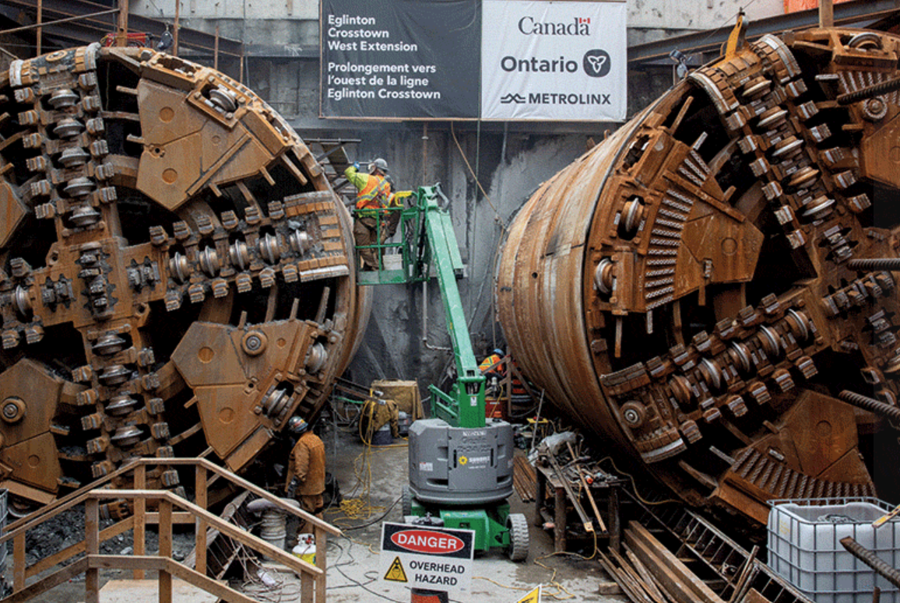
Digital Twins & AR : Transforming GC Operations
Main Use Cases
Digital Twins…
in aerospace
“Digital twin technology and virtual testing are advanced techniques designed to enhance the performance of Canada's aerospace value chain through innovation, to accelerate product development and to reduce the cost of maintenance and life-cycle cycle management.“
Digital twin and virtual testing focus area - National Research Council Canada
in construction
“Ontario’s recent $5-million investment in digital twin technology in projects such as the Eglinton Crosstown West Extension, marks a significant step in the evolution of using con-tech in public infrastructure projects.“
Unlocking the future of risk assessment with digital twins – ReNew Canada
Ontario Exploring New Technology to Build Critical Infrastructure Faster | Ontario Newsroom
in building management
“Montreal, QC – October 15th, 2024 - In collaboration with Public Services and Procurement Canada (PSPC), 3dverse will create an accessible web-based platform that will harness real-time data from IoT (Internet of Things) sensors. This technology will improve decision-making and optimize maintenance costs within energy, facility, and property management. “
3dverse — 3dverse has been awarded a contract by the Government of Canada and Innovative Solutions Canada (ISC) program to develop a groundbreaking real-time 3D digital twin platform.

Slide 8
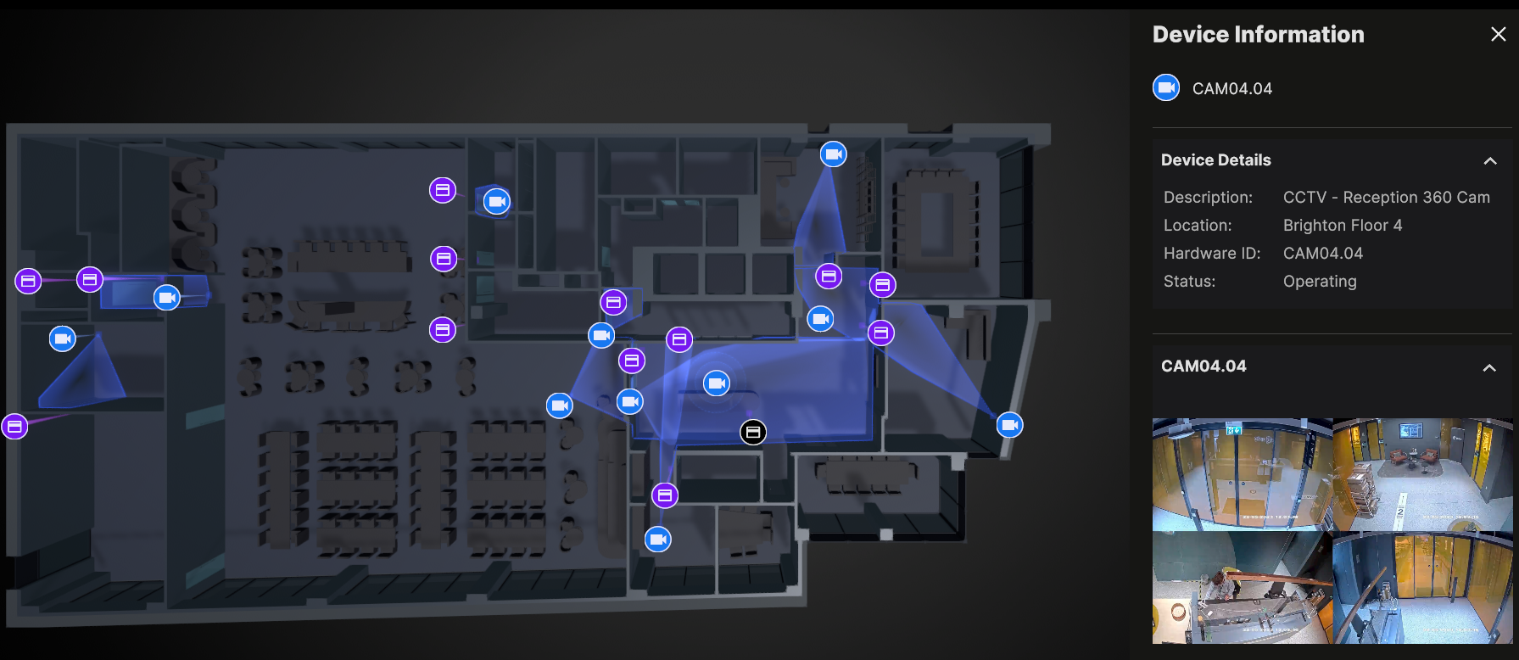
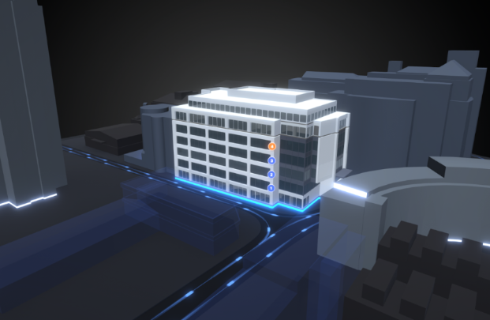
Digital Twins & AR : Transforming GC Operations
Floor Management Twins
Source : https://learn.unity.com/tutorial/introduction-to-digital-twins-with-unity

Slide 9
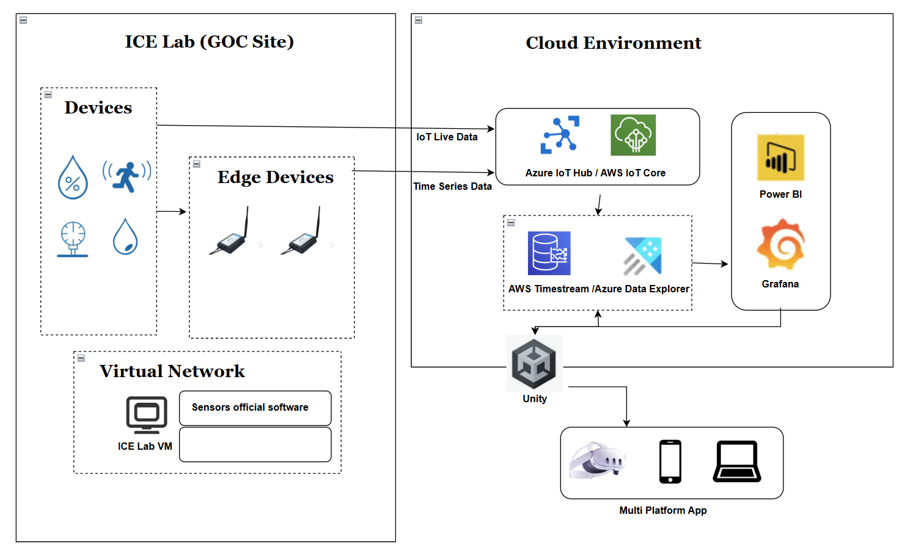
Digital Twins & AR : Transforming GC Operations
Our Proof of Concept (part 1)

Slide 10
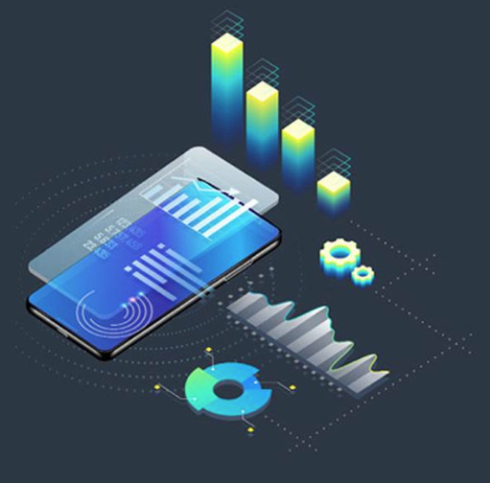


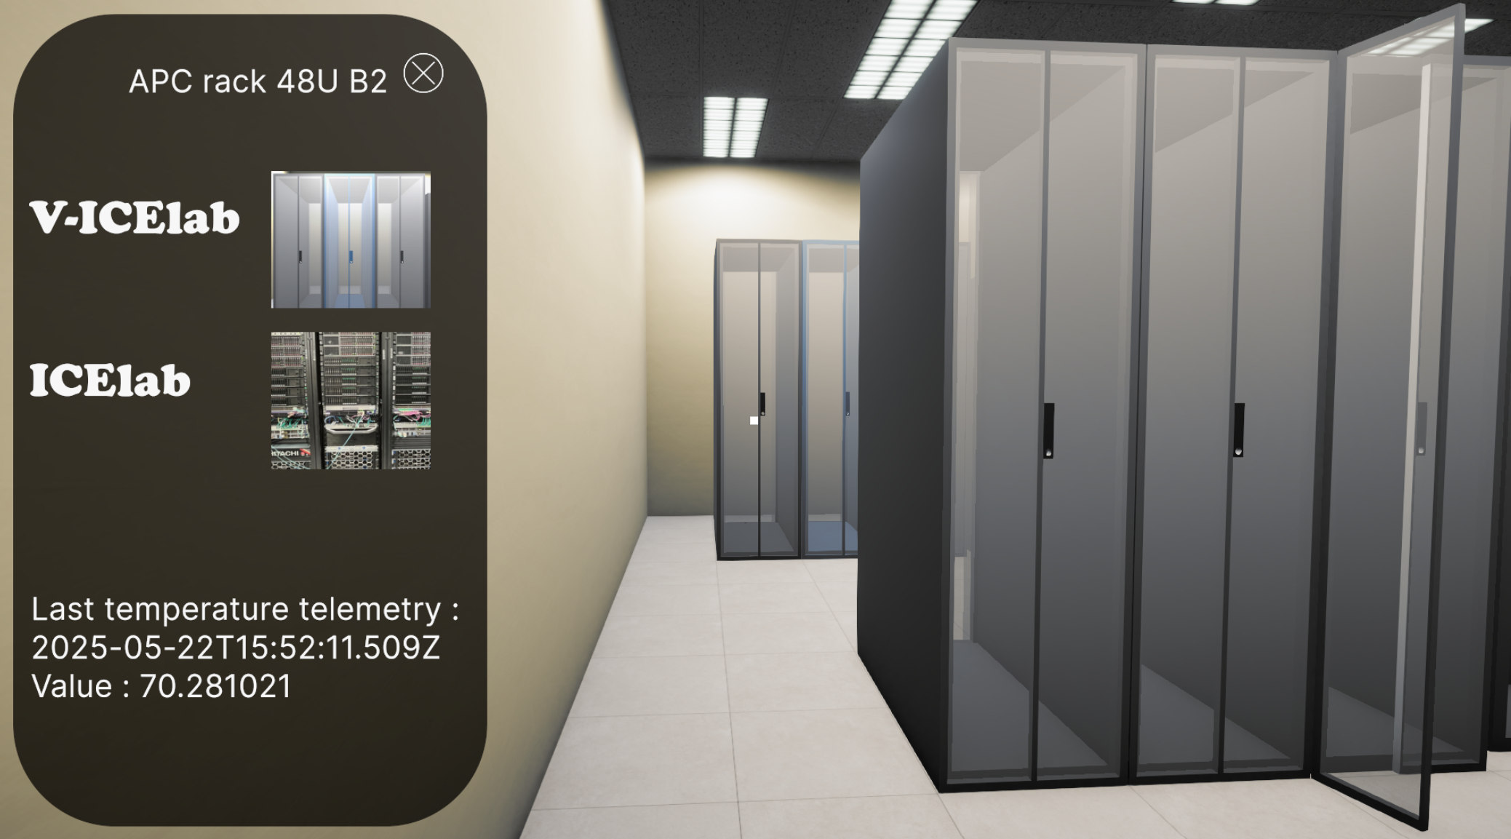
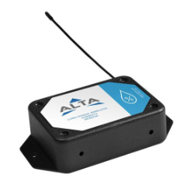
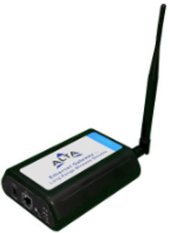

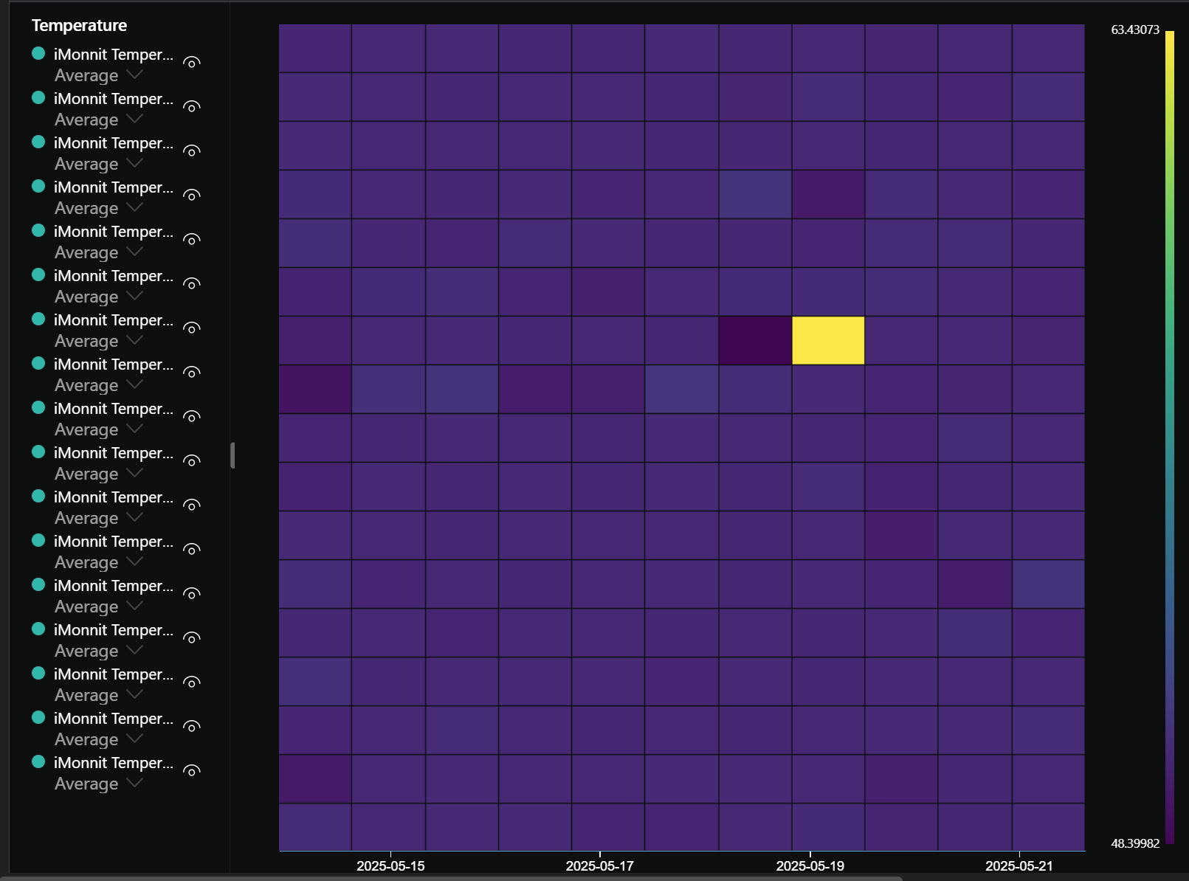

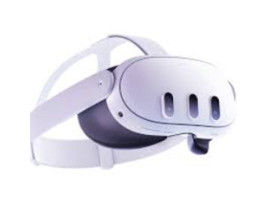



Digital Twins & AR : Transforming GC Operations
Our Proof of Concept (part 2)
Interaction and simulation
Monitoring
Storage and Analysis
++

Slide 11


Digital Twins & AR : Transforming GC Operations
Our Proof of Concept (part 3)
Unity
Why?
Flexibility
Simplicity
Adaptability
Possible integration

Slide 12
Digital Twins : Transforming Governments
Conclusion & Call to Action
Key takeaways
Why governments should Act Now
Encourage discussion, questions, and next steps

Slide 13
Join Us at our Digital Twins booth!
Experience Innovation:
Explore cutting edge IoT and Digital Twins solutions.
Live Demonstrations:
See our technology in action and understand its real-world applications.
Explore Insights:
Engage with our team of IoT specialists to get answers to your questions.

